Slide 1
Automobile World
DAB-103 Analytical Tools & Decision Making

Slide 2
Group 002
Group Members
1.Vishant Bhatia
2.Asbin Ghimire
3.Mahima Mehandiratta
4.Alisha Mahajan
5.Harshita Sanjay Dhiman

Slide 3
Contents
Proposal
Motivation
Problem Statement
Data Description
Target Audience
Analyzing Questions
Exploratory Data Analysis

Slide 4
Project Proposal
One could reasonably conclude that data rules the contemporary world. With every venture and activity providing a humongous amount of data, it has become the need to formulate and implement techniques for amalgamating, assimilating, and analysing such insights. With this project, our team aims to delve deep into the dataset and gain insights through descriptive analytics, exploratory data analytics techniques and visualizations. The team will work on the used cars dataset from different countries around the world. The team would be able to identify the sales according to the car's make, model, colour, depreciation, and top speed which would give the team a clear picture of the customer’s buying behaviour and preferences.

Slide 5
Motivation
The automobile industry, over the years, has revolutionized modern society making people more approachable to jobs and services, and above all personal freedom. Earlier, people relied on public transit to commute but with the comfort and ease that comes with a car, we have seen a huge shift from public transport to personal cars. However, not everyone can afford the luxury of a new car owing to numerous reasons thus increasing the market of used cars. The basis for selecting this dataset is to make data-driven decisions about sales of used cars in different countries based on different aspects such as the colour, make, model, depreciation, buyer gender and age, to name a few.

Slide 6
Problem Statement
Analyzing the dataset will help car dealers gain insights into the used car sales market. What are the factors that an individual considers while looking for a used car? Which gender across the globe is more inclined towards buying a used car rather than a new one? Which country around the world has a booming second-hand car market?

Slide 7
Data Description
Dataset Link: https://data.world/vizwiz/car-sales-mock-data
Rows: 10,000, Columns: 20
Data Types
Boolean
Float
Integer
object
Automobile World
Categorical
Make
model
Car gender
Buyer gender
Country
City
Buzzword
colour
New car
Numeric Variables
Buyer age
Dealer Latitude
Dealer longitude
Top speed
0-60 time
Discount
Sale price
Resale price

Slide 8
Target Audience
Our main target audience are the automobile dealers that will benefit from our project's EDA in order for them to achieve their objective to give their client the best deal possible. All of these will help to increase client happiness and business expansion overall.

Slide 9
Analyzing Questions
Explain the sales and profits of second-hand cars market across the globe.
How to recommend a car with its model or by special features?
Which maker has more resell value?
Is the car worth the money? (comparison between a car’s sale price and resell price)
Comparing the depreciation of new and old cars for different companies.
Which age group and gender is more inclined towards purchasing cars?
How to depict country-by-country sales of automobile manufacturers?

Slide 10
GitHub repository link:-
https://github.com/harshita0410/automobile_project

Slide 11
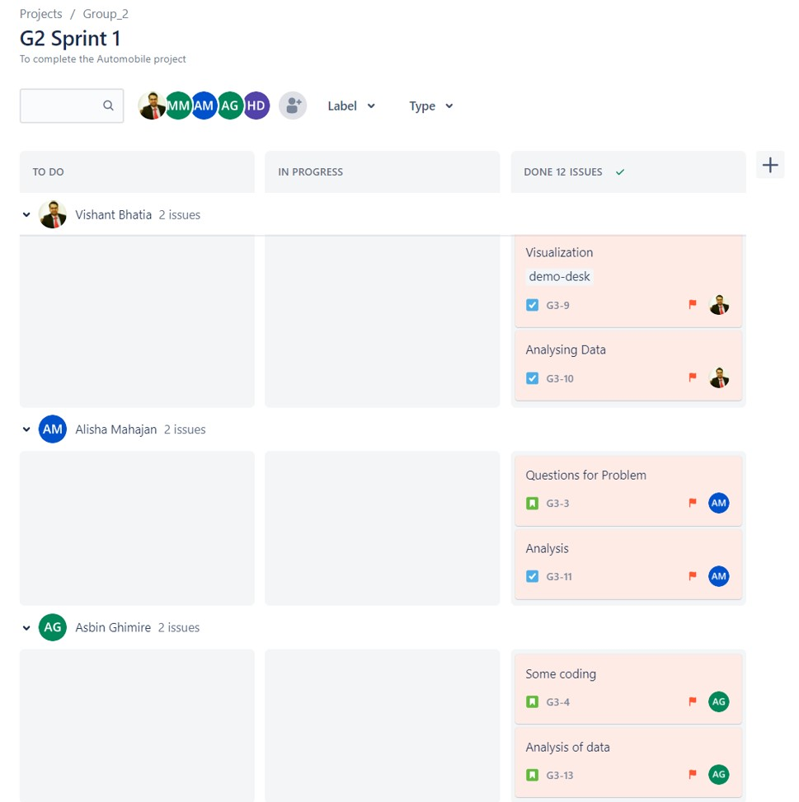
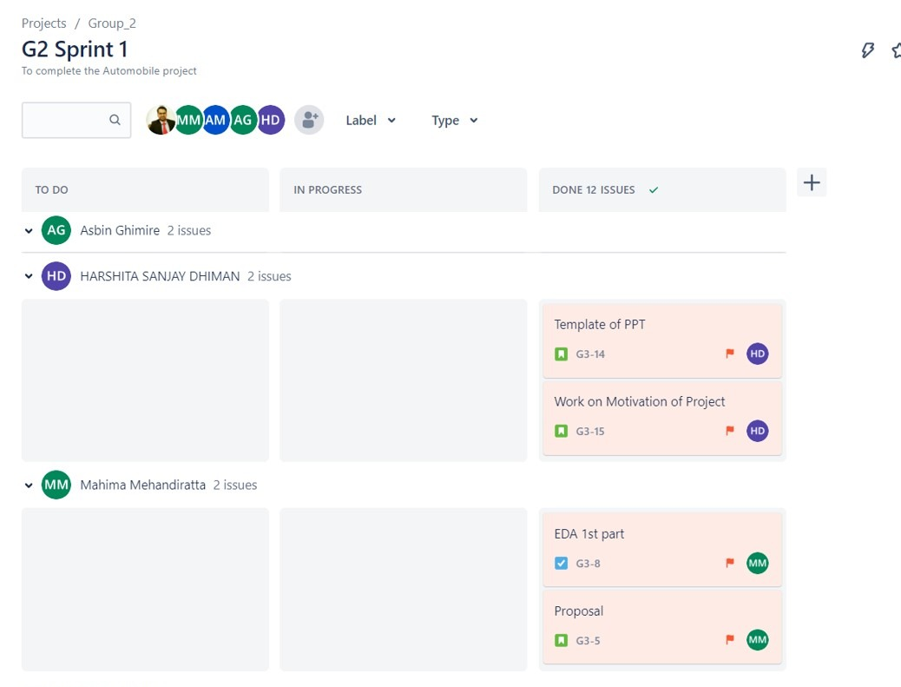
Jira work distribution

Slide 12
Exploratory Data Analysis

Slide 13
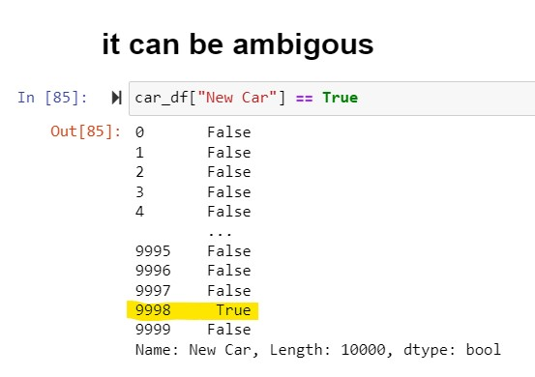
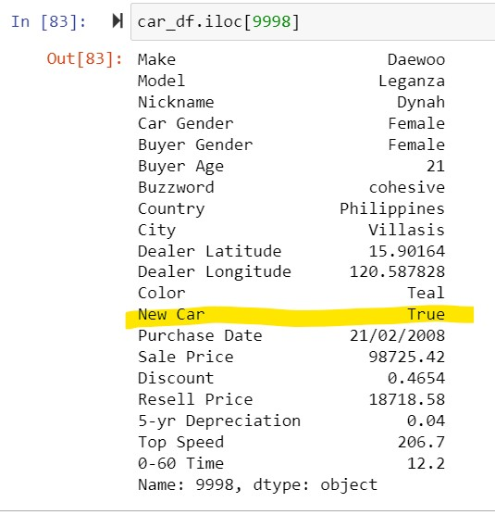
We are analysing the ambiguity of our dataset.
The new car has a resell price.

Slide 14
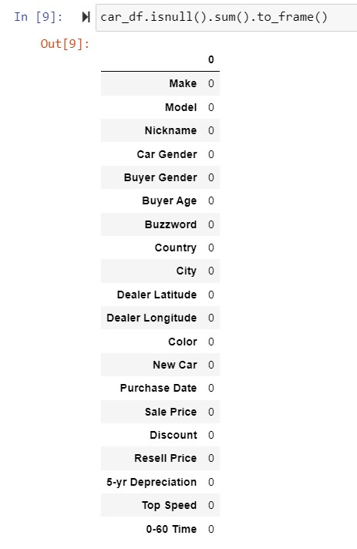
Table for the count of null values in the
dataset.

Slide 15
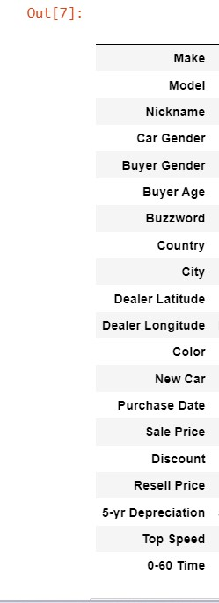
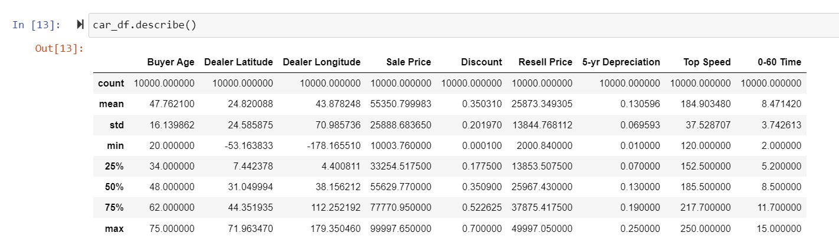
Calculation of certain statistical information about the dataset’s numerical values, such as percentile, mean, and standard deviation.

Slide 16
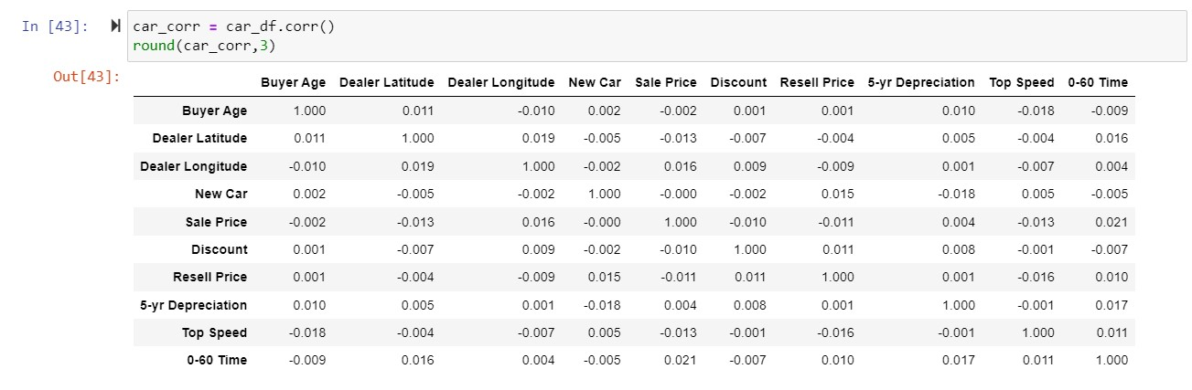
Corelation between different features of our datasets .

Slide 17
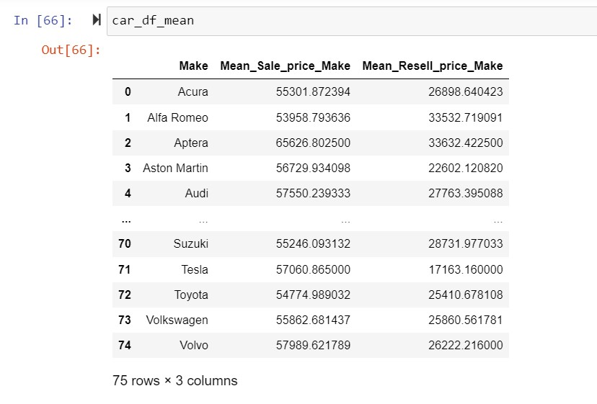
This table depicts the mean of sale and resell price of different car companies.

Slide 18
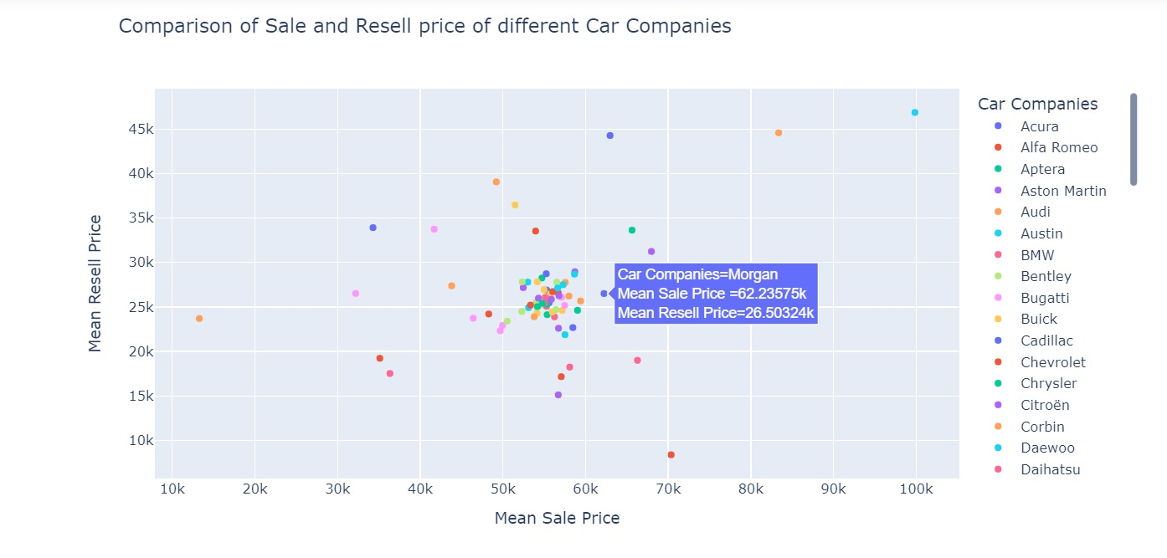
Analysis of sale and resell price of different car companies .

Slide 19
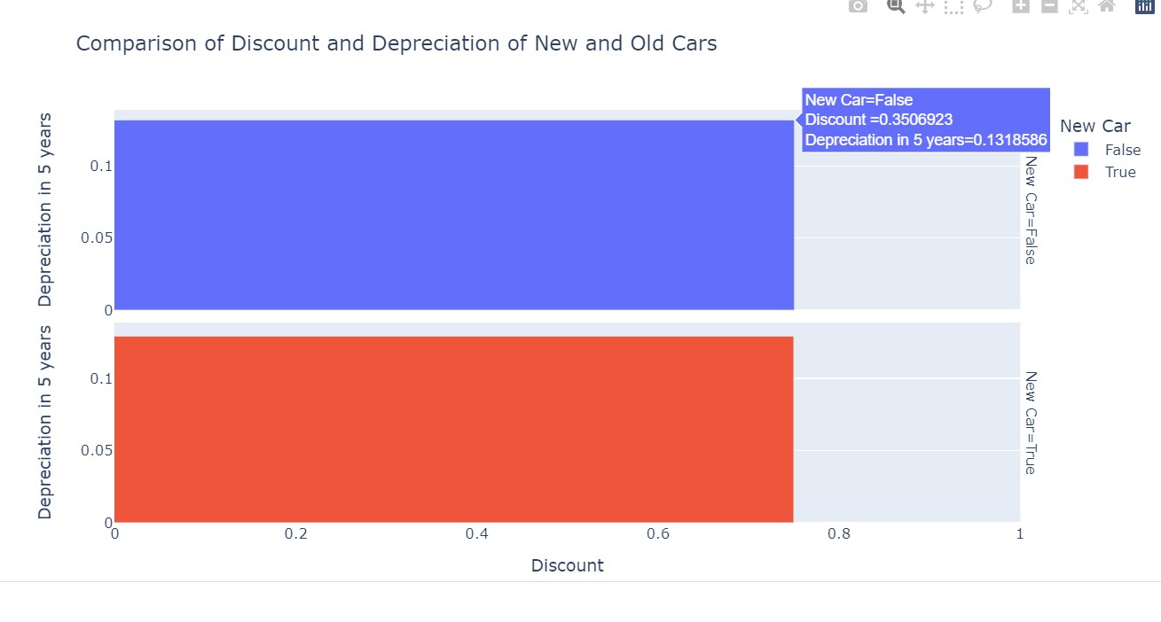
Analysis of discount and depreciation of different cars.

Slide 20
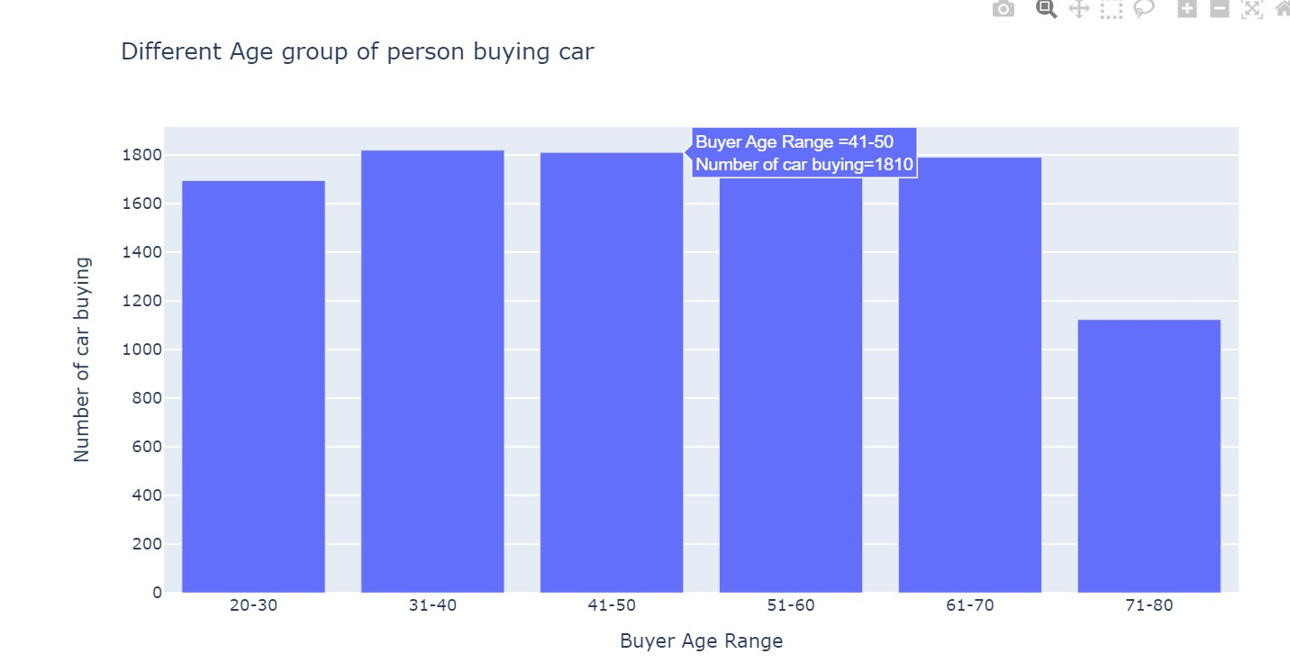
Analysis of different age groups buying the car.

Slide 21
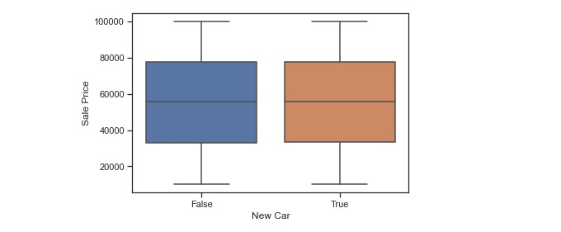
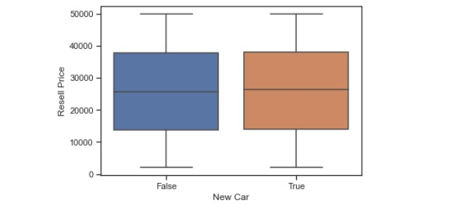
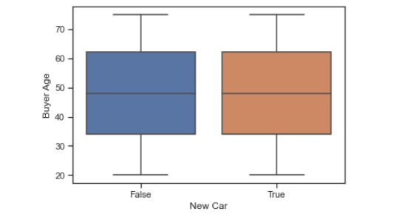
In the above-mentioned plots, we can see the x-axis has details if the car is old or new whereas the y-axis in 1st plot defines sale price, in 2nd the resell price and in 3rd , the buyer age .

Slide 22
Thank You !

